Slide 2
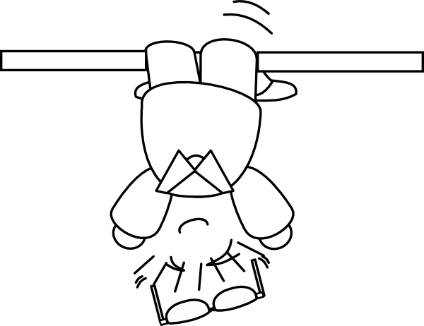
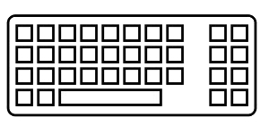
Coding backwards
in order to
to think straight
2nd part
Deepening TDD practice with
Outside-In TDD

Slide 3
TDD …
… what's that again?

Slide 4
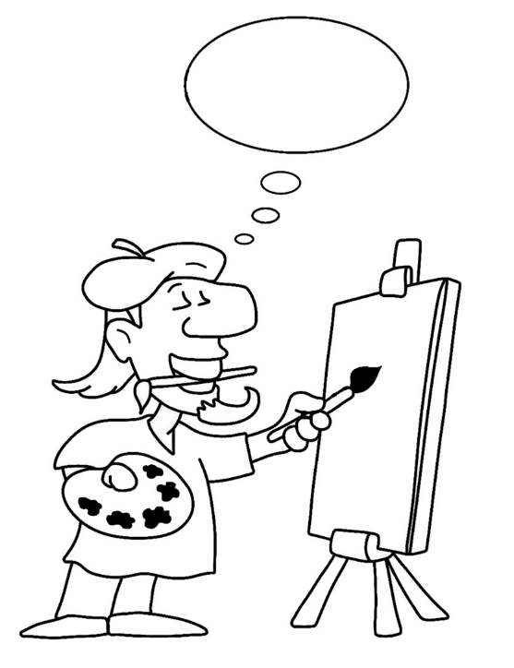
Two main
« styles » of TDD

Slide 5
Two main
« styles » of TDD
Classical
Outside-in

Slide 6
Two main
« styles » of TDD
« Detroit School »
« London School »
Classical
Outside-in

Slide 7
Two main
« styles » of TDD
« Detroit School »
« London School »
Classical
Outside-in
= state verification
= behaviour verification

Slide 8
« Classical » TDD

Slide 9
RED
REFACTOR
GREEN

Slide 10
RED
Write a single test and watch it fail

Slide 11
RED
Write just enough code to make
the test pass
Write a single test and watch it fail
GREEN

Slide 12
RED
Write just enough code to make
the test pass
Write a single test and watch it fail
REFACTOR
GREEN
Improve the quality of the code, and also of the test

Slide 13
Consider the requirement
RED
Write just enough code to make
the test pass
Write a single test and watch it fail
REFACTOR
GREEN
Improve the quality of the code, and also of the test

Slide 14
Consider the requirement
RED
Write just enough code to make
the test pass
Write a single test and watch it fail
REFACTOR
GREEN
The main design effort occurs here
Improve the quality of the code, and also of the test

Slide 15
RED
REFACTOR
GREEN

Slide 16
« Outside In » TDD

Slide 17
RED
RED
GREEN
REFACTOR
REFACTOR
GREEN

Slide 18
RED
Write a single acceptance test and watch it fail

Slide 19
RED
Write a single acceptance test and watch it fail
RED
Write a single unit test and watch it fail

Slide 20
RED
Write a single acceptance test and watch it fail
RED
Write just enough code to make
the test pass
GREEN

Slide 21
RED
Write a single acceptance test and watch it fail
GREEN
REFACTOR
RED
Improve the quality of the code, and also of the test

Slide 22
RED
Iterate TDD cycles with unit tests until the acceptance test itself does pass
Write a single acceptance test and watch it fail
RED
GREEN
REFACTOR

Slide 23
RED
Iterate TDD cycles with unit tests until the acceptance test itself does pass
Write a single acceptance test and watch it fail
RED
GREEN
REFACTOR
GREEN

Slide 24
RED
Iterate TDD cycles with unit tests until the acceptance test itself does pass
Write a single acceptance test and watch it fail
RED
GREEN
REFACTOR
REFACTOR
GREEN
Improve the quality of the code, and also of the test

Slide 25
Consider and express the requirement
RED
RED
GREEN
REFACTOR
REFACTOR
GREEN

Slide 26
Consider and express the requirement
RED
The main design effort occurs here
RED
GREEN
REFACTOR
REFACTOR
GREEN

Slide 27
Consider and express the requirement
RED
The main design effort occurs here
A secondary design effort occurs here
RED
GREEN
REFACTOR
REFACTOR
GREEN

Slide 28
RED
RED
GREEN
REFACTOR
REFACTOR
GREEN

Slide 29
Okay, but …
… for what purpose?

Slide 30
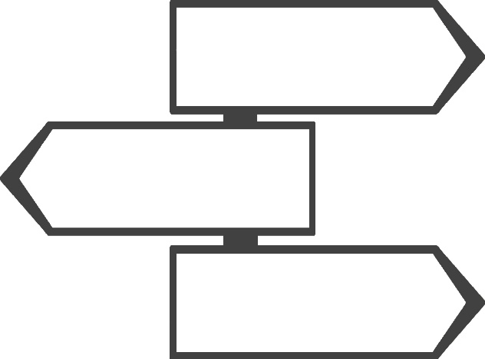
The Use Case
as central focus

Slide 31
The Use Case
as central focus
« Framing » use cases closer to business needs
An indicator of progress in the product, over time
Design effort occurs earlier in the development cycle
The preponderance of truly unit tests is facilitated

Slide 32
Okay, but …
… why focus on unit tests?

Slide 33
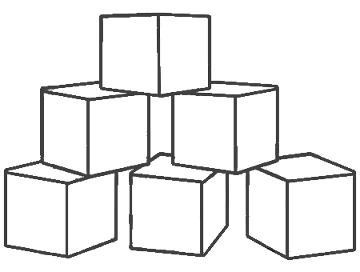
The Test Pyramid

Slide 34
The Test Pyramid

Slide 35
The Test Pyramid
Unit Tests

Slide 36
The Test Pyramid
Integration Tests
Unit Tests

Slide 37
The Test Pyramid
End-to-End Tests
Integration Tests
Unit Tests

Slide 38
The Test Pyramid
End-to-End Tests
-
+
Integration Tests
Speed
Cost
+
Unit Tests
-

Slide 39
Okay, but …
… how to get there?

Slide 40

Powerful allies :
Test Doubles

Slide 41
Powerful allies :
Test Doubles
Dummy, Fake, Stub, Spy, Mock … often simplified as: Mock
Collaborators are only revealing their interfaces
Their behaviours and interactions are checked, not their states
One same test truly has only one single reason to fail

Slide 42

Public interface
standing as a contract

Slide 43
Public interface
standing as a contract
Business object interfaces define their behavior
The separation of responsibilities and dependencies is facilitated
Tests can be truly effective unit ones, as they are in isolation

Slide 44
Some reminders

Slide 45
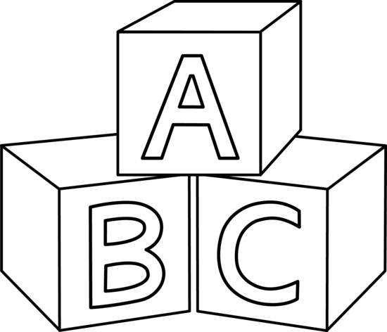
Four Rules
of Simple Design
Passes the tests
Reveals intention
No duplication
Fewest elements
+
Priority
-

Slide 46

Some guidelines for
the development cycle
Add one (and only one) new test while in « Green »
(at a same given test level: unit / acceptance)
Watch the test fail before coding corresponding solution
Code in order to return as soon as possible to « Green »
Refactor code or test at any one time, not both

Slide 47
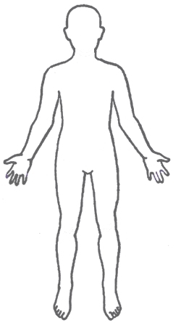
Anatomy of a Test
3
GIVEN
WHEN
THEN
Context
Event
Expectation
= states / data
= what is being tested
= solution to the requirement
2
1

Slide 48
RED
RED
GREEN
REFACTOR
REFACTOR
GREEN

Slide 49
Now let’s do some coding!

Slide 50
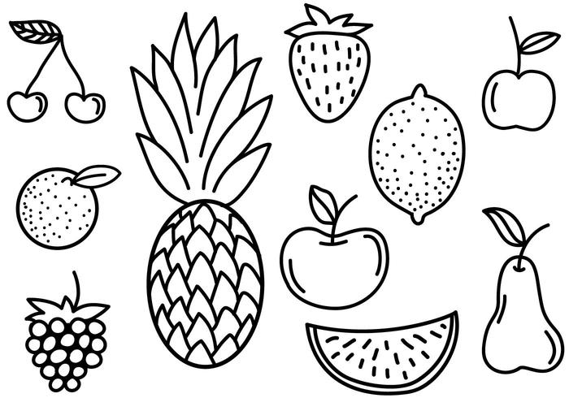
Fruit Shop
Charge the right amount when the customer goes to the checkout.
Business rules (prices in cents):
1 apple costs 100
1 banana costs 150
1 cherry costs 75

Slide 51
FruitShopTest

Slide 52
FruitShopTest
@Test public void noCheckoutForEmptyCart() { }

Slide 53
FruitShopTest
@Test public void noCheckoutForEmptyCart() { // THEN assertThat(totalAmount).isEqualTo(0); }

Slide 54
FruitShopTest
@Test public void noCheckoutForEmptyCart() { // WHEN int totalAmount = checkout.computeTotalAmount(); // THEN assertThat(totalAmount).isEqualTo(0); }

Slide 55
FruitShopTest
@Test public void noCheckoutForEmptyCart() { // GIVEN // Empty cart // WHEN int totalAmount = checkout.computeTotalAmount(); // THEN assertThat(totalAmount).isEqualTo(0); }

Slide 56
FruitShopTest
private Checkout checkout = new Checkout();
@Test public void noCheckoutForEmptyCart() { // GIVEN // Empty cart // WHEN int totalAmount = checkout.computeTotalAmount(); // THEN assertThat(totalAmount).isEqualTo(0); }

Slide 57
FruitShopTest
private Cart cart = new Cart(); private Checkout checkout = new Checkout(cart);
@Test public void noCheckoutForEmptyCart() { // GIVEN // Empty cart // WHEN int totalAmount = checkout.computeTotalAmount(); // THEN assertThat(totalAmount).isEqualTo(0); }

Slide 58
CheckoutTest

Slide 59
CheckoutTest
@Test public void noCheckoutForEmptyCart() { }

Slide 60
CheckoutTest
@Test public void noCheckoutForEmptyCart() {
// THEN
assertThat(totalAmount).isEqualTo(0); }

Slide 61
CheckoutTest
@Test public void noCheckoutForEmptyCart() {
// WHEN
int totalAmount = checkout.computeTotalAmount();
// THEN
assertThat(totalAmount).isEqualTo(0); }

Slide 62
CheckoutTest
private Checkout checkout = new Checkout();
@Test public void noCheckoutForEmptyCart() {
// WHEN
int totalAmount = checkout.computeTotalAmount();
// THEN
assertThat(totalAmount).isEqualTo(0); }

Slide 63
CheckoutTest
private Checkout checkout = new Checkout();
@Test public void noCheckoutForEmptyCart() {
// GIVEN
given(cart.listFruits())
.willReturn(Collections.emptyList());
// WHEN
int totalAmount = checkout.computeTotalAmount();
// THEN
assertThat(totalAmount).isEqualTo(0); }

Slide 64
CheckoutTest
private Cart cart = new Mock(Cart.class); private Checkout checkout = new Checkout(cart);
@Test public void noCheckoutForEmptyCart() {
// GIVEN
given(cart.listFruits())
.willReturn(Collections.emptyList());
// WHEN
int totalAmount = checkout.computeTotalAmount();
// THEN
assertThat(totalAmount).isEqualTo(0); }

Slide 65
Fruit Shop
Charge the right amount when the customer goes to the checkout.
Business rules (prices in cents):
1 apple costs 100
1 banana costs 150
1 cherry costs 75

Slide 66
Fruit Shop
Charge the right amount when the customer goes to the checkout.
Business rules (prices in cents):
1 apple costs 100
1 free apple when two bought apples
1 banana costs 150
1 cherry costs 75

Slide 67
Fruit Shop
Charge the right amount when the customer goes to the checkout.
Business rules (prices in cents):
1 apple costs 100
1 free apple when two bought apples
1 banana costs 150
The second banana is half price
1 cherry costs 75

Slide 68
Fruit Shop
Charge the right amount when the customer goes to the checkout.
Business rules (prices in cents):
1 apple costs 100
1 free apple when two bought apples
1 banana costs 150
The second banana is half price
1 cherry costs 75
A loyalty program customer is entitled to a 10% discount

Slide 69
One possible solution

Slide 70
Acceptance Test
FruitShopTest
Cart
Checkout
Pricing
Fake
Persistence
Fruit

Slide 71
Unit Tests
CartTest
CheckoutTest
PricingTest
Cart
Checkout
Pricing
Mock
Cart
Mock
Pricing
Mock
Persistence
Fruit

Slide 72
Implementation
Checkout
Cart
Pricing
Persistence
Fruit

Slide 73


